Slide 1
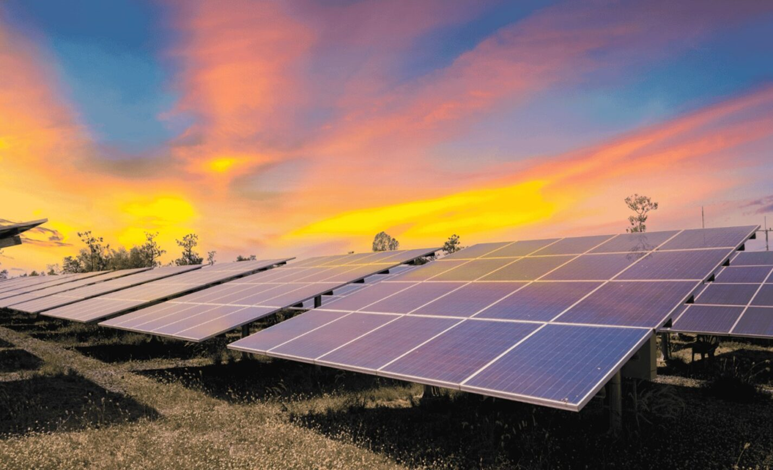
Sustainable Energy System
Team Name: Elite Solutions
Group no: 3
Members: Nguyen Manh Dung, Tran Yen Nhi, Nguyen Tran Yen Binh, Tran Hoang Hai Anh, Tran Hai Long

Slide 2
TEAM MEMBERS
Nguyen Manh Dung
Team Leader
Tran Yen Nhi
Team Manager
Tran Hoang Hai Anh
Technological Advisor
Tran Hai Long
Engineer
Nguyen Tran Yen Binh
Data Researcher

Slide 3
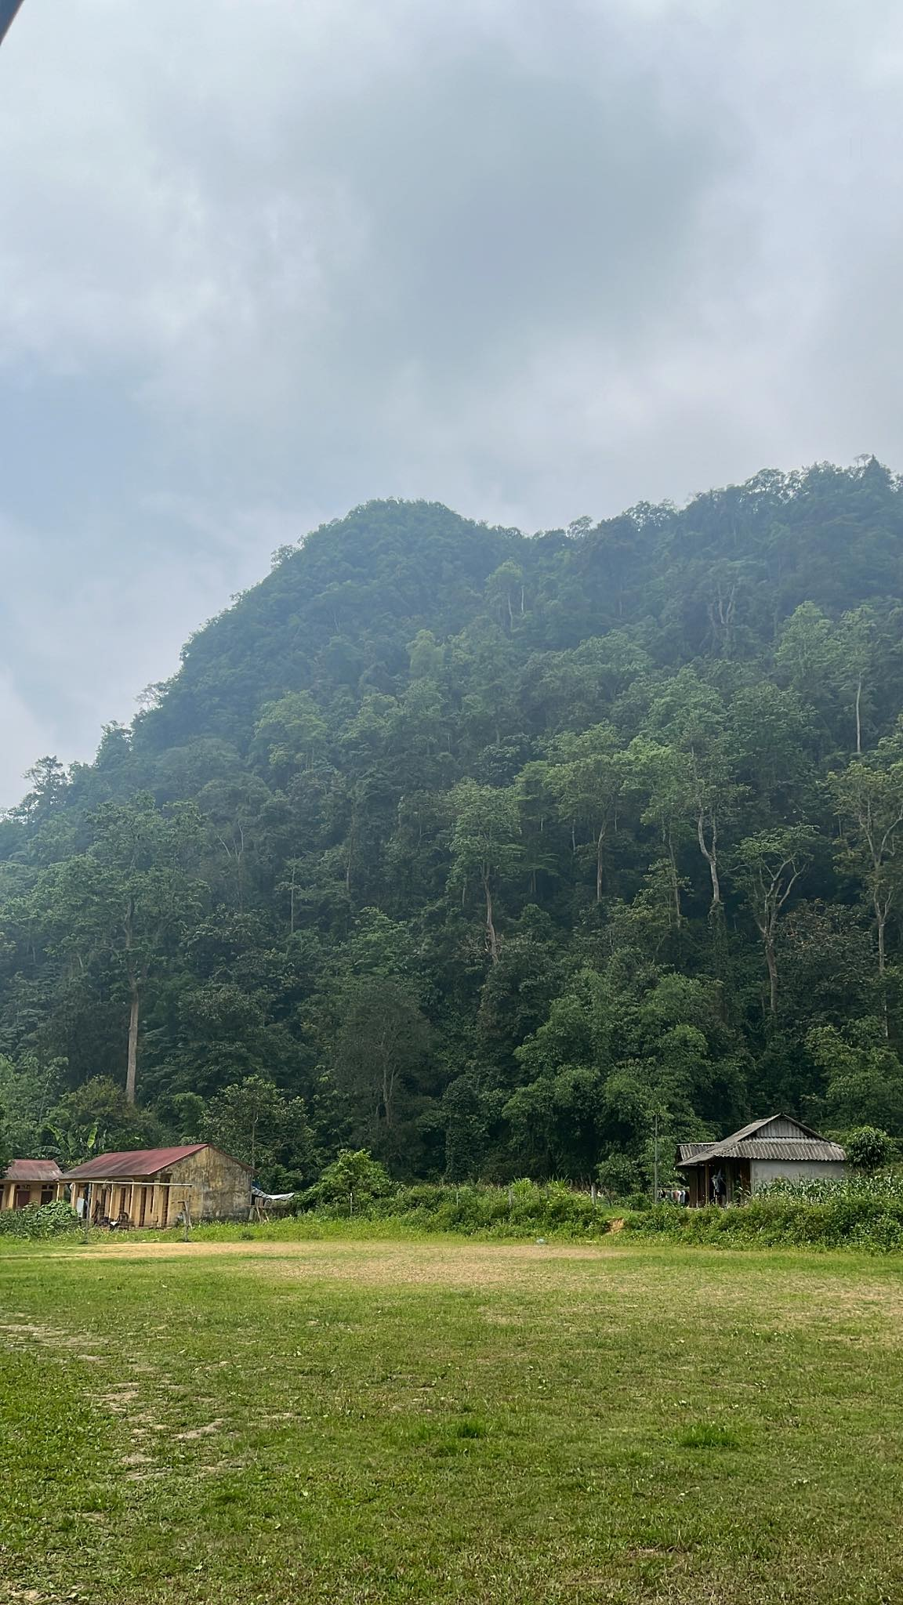
Acknowledgement of Xuan Son
It is located approximately 80 km from Việt Trì City. The park covers an area of 15,048 hectares (37,180 acres), with more than 11,000 hectares (27,000 acres) of natural forests and 1,396 hectares (3,450 acres) of limestone-mountain forests.
2023-HX05 COS10025-Technology in an Indigenous Context

Slide 4

Overview
The project aims to provide a sustainable energy system for Xuan Son, Phu Tho by harnessing solar energy.
The project addresses four key functions of the project:
Environmental inspections for the solar panels
Building the infrastructure
Optimising the system
Long-term maintenance
2023-HX05 COS10025-Technology in an Indigenous Context

Slide 5

Project Background
Phu Tho faces significant energy challenges due to their remoteness and limited access to reliable power sources. Dependence on fossil fuels for electricity generation contributes to environmental degradation and a lack of energy security. The existing system does not work well due to being in a rural area, the system risks many problems, therefore, might affect the results of obtaining solar energy (Sinha and Chandel 2014). Also, the small-scale system is expected to function seamlessly in a decent condition, which Xuan Son is not idealistic. As a result, some issues were identified:
Xuan Son is home to a national forest, which make solar panels placement might be concerning
Located in a mountainous area, arising the issue of connectivity
The project could be not maximized, leads to energy wastage and low efficiency
The system could experience low lifespan, as well as reduced reliability without proper maintenance
2023-HX05 COS10025-Technology in an Indigenous Context

Slide 6

Project Scope
Project Goals and Objectives:
Address different sides of the project
Calculate the expected budget
In this project we are expected to provide the following:
A prototype
Estimated budget
Material to accompany the solutions
Impact of the solutions
Detailed outline of the solutions
Efficiency of the solutions
The solutions developed are required to follow the following aspects:
Environmental preservation
Efficiency and longevity of the system
Affordability
Sustainable livelihood
Sustainable energy access
Knowledge for the community
2023-HX05 COS10025-Technology in an Indigenous Context

Slide 7
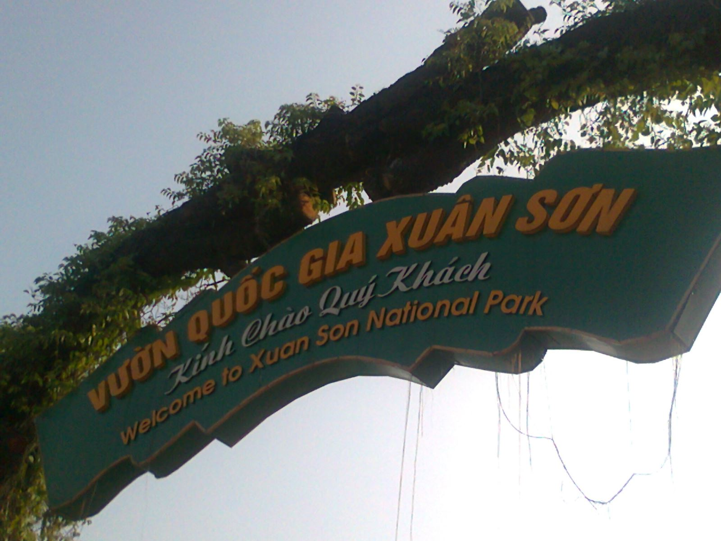
Design idea/concept 1: Environmental Inspections
Learning issue/problem
Challenges of Phu Tho terrain and environments:
A lack understanding of environmental impacts and rugged mountainous terrain.
Difficulties locating and analysing information are caused by poor network connections and unoptimised infrastructure. This does not even consider the dangers we face in rural areas, such as wild animals, dangerous weather, and extreme heat.
2023-HX05 COS10025-Technology in an Indigenous Context
Notes:
arbitrarily put solar panels, it might harm the scenery
Installing solar power systems in poor-quality regions or along current transmission and transportation routes might lessen the impact.

Slide 8

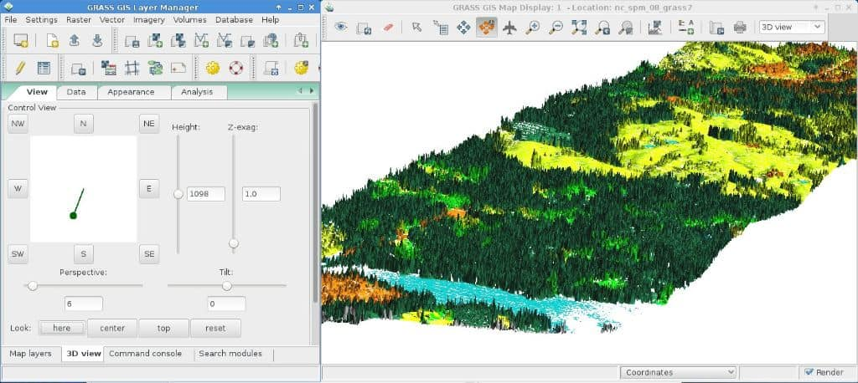
Design idea/concept 1: Environmental Inspections
Design outline
Design a layout that encourages eco-friendly habits, energy efficiency, and a healthy environment for peoples. Is essential to creating a sustainable learning environment.
Layout
Implement GRASS GIS (Geographic Resources Analysis Support System) in rural areas.
Analyze environment and terrain to exclude data sources we used in GRASS GIS.
2023-HX05 COS10025-Technology in an Indigenous Context
Notes:
built for vector and raster geospatial data management, geoprocessing, spatial modelling and visualization.

Slide 9
Design idea/concept 1: Environmental Inspections
Design benefits
This program attempts to maximise the use of GRASS GIS by speeding up the process for analysis and civil engineering projects. For example, academic department love GRASS GIS for its scientific tools, extensive documentation, and proven track record.
Cost-Effective Analysis Methods: Allows rural communities to monitor land use changes and make informed decisions for sustainable agricultural practices and environmental conservation.
Easy Extract Data: Multiple data input formats are available, including MySQL, .DBF …
Best GIS technology you can find: GRASS GIS contains over 500 modules to process and gender geographic data.
2023-HX05 COS10025-Technology in an Indigenous Context
Notes:
3D modules

Slide 10
Design idea/concept 1: Environmental Inspections
Estimation of the design budget
Name | Price range | Feature and Specifications | Quantity
Laptop | 1000$-2000$ | Operating Systems: sufficient RAM (recommended 8GB or more) | 2-3 devices
AWS (Amazon Web Services) | Free (Free tier) | Cloud-Based Infrastructure | 1-2 Database
GRASS GIS | Free (Open-source) |  | 1
Labour | 2500$ | Assistant | 2-3 person
2023-HX05 COS10025-Technology in an Indigenous Context

Slide 11


Learning issue - design outline
During a field trip to Phu Tho, researchers discovered the importance of a suitable connection method for a renewable energy data control system in Xuan Dai. Wireless communication systems and physical cables are not suitable due to mountainous terrain and potential environmental damage.
To implement satellite connectivity, configure a solar panel chip to send data to the satellite cloud. Determine unique requirements, such as data transfer rate, bandwidth, coverage region, and price. Research satellite providers and ensure compatibility. Install, configure, test, secure, and monitor the connection for stability and dependability. Regular maintenance is recommended for optimal system functioning.

Slide 12
Benefit and challenge
Benefit:
Providing extensive coverage and high-speed internet access equivalent to other broadband solutions
Dependable and adaptable
Multiple devices connection
Challenge:
Restricted bandwidth
Greater initial setup costs and monthly subscription prices
Installation and maintenance tasks

Slide 13
Estimation of the design budget
Name of software /hardware service | MediaTek MT6825 | Azure Space from Microsoft | Installation and maintenance
Description | Satellite connection chip | Satellite cloud platform | Labour and developer
Price | $100 per platforms | 0
Subscription Price | 0 | $11,963/month | 10.000 / month

Slide 14

Design idea/concept 3: Optimise and Improve the Solar System
Learning issue/problem
Focus on improving the solar energy system's performance and efficiency
Aim to continuously collect and analyze crucial data points, enabling valuable insights
2023-HX05 COS10025-Technology in an Indigenous Context

Slide 15
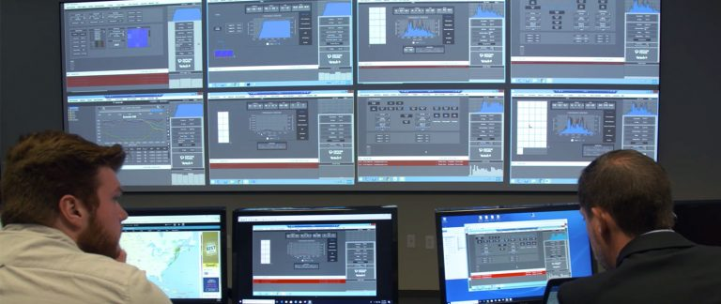

Design idea/concept 3 : Optimise and Improve the Solar System
Design outline
Data Acquisition
SCADA System
Communication Infrastructure
Data Analysis and Visualization
Remote Monitoring and Control
2023-HX05 COS10025-Technology in an Indigenous Context

Slide 16

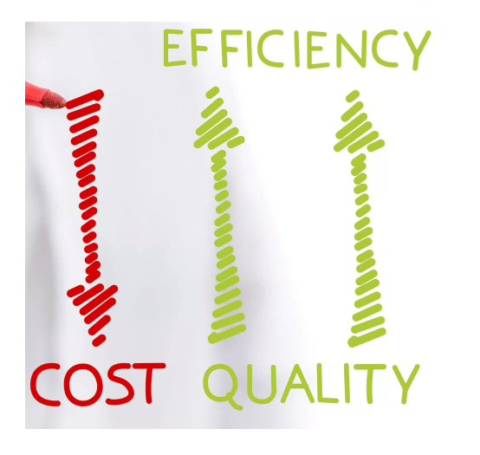

Design idea/concept 3 : Optimise and Improve the Solar System
Design benefits
Access to clean and reliable energy for rural communities, such as Phu Tho.
Reduce operational costs, increasing return on investment and accessibility for communities with limited financial resources.
Foster sustainable livelihoods by creating job opportunities and enhancing overall socio-economic development.
2023-HX05 COS10025-Technology in an Indigenous Context

Slide 17
Design idea/concept 3 : Optimise and Improve the Solar System
Estimation of the design budget
Cost Category | Estimated Cost (USD)
Sensor Devices | $270 - $750
Solar Irradiance Sensor: Pyranometer | $200 - $600
Temperature Sensor: Thermocouple Sensor | $50 - $100
Battery Charge Level Sensor: Voltage Sensor | $20 - $50
SCADA Software and Licensing | $2,250 - $5,650
SCADA Software: Ignition SCADA Software by Inductive Automation | $2,000 - $5,000
Licensing: Client Access Licenses (CALs) for remote monitoring | $200 - $500
Database Management System (DBMS): MySQL Community Edition | Free
Security and Encryption: SSL/TLS Certificates: $50 to $150 | $50 - $150

Slide 18
Estimation of the design budget
Cost Category | Estimated Cost (USD)
Communication Infrastructure | $800 - $1,130
Wireless Modems/Routers: Sierra Wireless AirLink RV50X | $600 - $800
Antennas: Panorama LPB low profile antenna | $50 - $80
Industrial Ethernet Switch: Moxa EDS-205A | $100 - $150
Network Cables: CAT6 Ethernet Cables (Various Lengths) | $50 - $100
Solar-Powered Communication Solutions: Compact Solar Kit (e.g., Renogy, Goal Zero) | $800 - $1,200
Installation and Integration Services | $3,000 - $5,000
Labour | $800 - $1,500
Electrician | $200 - $500
Quality Assurance Engineer | $500 - $700
Technical Writer | $100 - $300
Total | ~$10,400
Contingency (10% of Total) | ~$1,040

Slide 19


Design idea/concept 4: Long-Term Operation and Maintenance
Learning issue/problem
Importance of routine maintenance.
Identifying performance difficulties.
Basic maintenance procedures.
Troubleshooting and problem-solving.
Seeking professional support.
2023-HX05 COS10025-Technology in an Indigenous Context

Slide 20
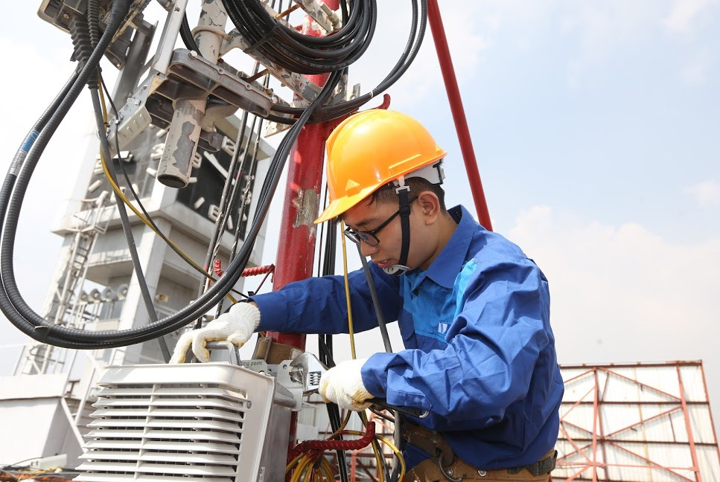
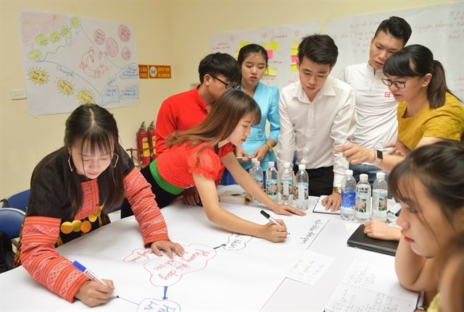
Design idea/concept 4: Long-Term Operation and Maintenance
Design Outline
Community training and education
Local technicians and support networks
Remote monitoring and diagnostic tools
Collaborative maintenance programs
Accessible platforms for collaboration
2023-HX05 COS10025-Technology in an Indigenous Context

Slide 21

Design idea/concept 4: Long-Term Operation and Maintenance
Design Benefits
Improved system performance
Prolonged system lifespan
Local empowerment and skill development
Cost savings
Sustainable energy access
2023-HX05 COS10025-Technology in an Indigenous Context

Slide 22
Design idea/concept 4: Long-Term Operation and Maintenance
Estimation of the design budget
Design component | Estimated cost
Community training and education | $1000
Local technicians and support network | $1400
Remote monitoring and diagnostic tools | $1000
Collaborative maintenance programs | $800
Miscellaneous and Contingency | $400
Total estimated design budget | $4600

Slide 23
Our Website

Slide 24
REFERENCES
Sinha, S. and S. Chandel (2014). "Review of software tools for hybrid renewable energy systems." Renewable and sustainable energy reviews 32: 192-205.

Slide 25
Thank you

